Slide 1
Marketing Strategy of Dunkin donuts - Dunkin donuts Marketing Strategy

Slide 2
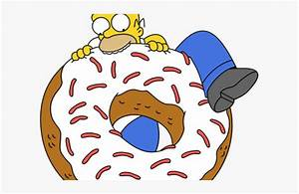
World’s leading Quick service restaurants (QSR) working on the franchise model have more than 11000 outlets worldwide working under the umbrella brand of Dunkin Brands. Being 65 years old company Dunkin’ Donuts has emerged as an America’s favourite doughnut company offering coffee, baked goods and other beverages.

Slide 3
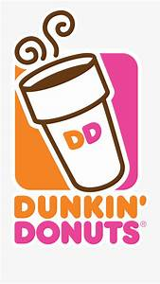
Segmentation, targeting, positioning in the Marketing strategy of Dunkin donuts –
Dunkin doughnuts use geographic segmentation strategies to cater to the needs of the consumers in 40+ countries worldwide. It uses undifferentiated targeting strategy so as to make the same menu available globally irrespective of the geographic boundaries. Dunkin donuts have positioned itself based on the kind of product it has in its product portfolio.

Slide 4
Marketing mix – Here is the Marketing Mix of Dunkin Donuts. SWOT analysis – Here is the SWOT analysis of Dunkin Donuts. Mission- “To be the leading provider of the wide range of baked foods & beverages” Vision- “To be always the desired place for great coffee beverages and delicious complimentary donuts & bakery products to enjoy with family and friends” Tagline-“Get your mojo back”

Slide 5
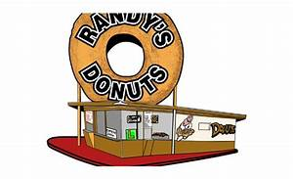
Competitive advantage in the Marketing strategy of Dunkin Donuts –
Being the market leader in the category and maintaining the same for years is commendable. Dunkin Donuts is a market leader in flavoured coffee, muffins and doughnuts. Strong parent company: Dunkin Brands Group Inc. has two brands namely Dunkin Donuts and Baskin Robbins under its group company which is divided into 4 businesses.

Slide 6
Dunkin’ Donuts U.S., Baskin-Robbins U.S, Dunkin’ Donuts International and Baskin-Robbins International. 100% franchised model: The group have 19000+ outlets in total which is 100% franchised and is helping the company to control its operational cost and earn profits in terms of royalties.

Slide 7
BCG Matrix in the Marketing strategy of Dunkin Donuts –
As Dunkin Donuts is the market leader in the business it operates and that’s why it is the star in the BCG matrix.

Slide 8
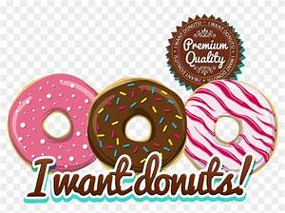
Distribution strategy in the Marketing strategy of Dunkin Donuts –
With a presence in 42 countries and having 3300+ restaurants has helped the company in decreasing it’s over dependence in U.S market and generating revenues through developing Asian markets. In the case of sourcing the raw materials, the franchises independently source the materials by themselves subject to compliant with the Dunkin’s standards while many franchises source the doughnuts from the approved third-party supplier in the market.

Slide 9
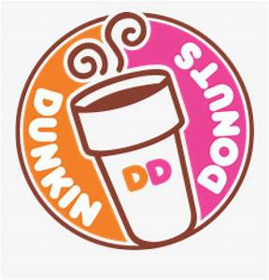
Brand equity in the Marketing strategy of Dunkin Donuts –
For 10th consecutive year, the brand Dunkin has been recognized as a top brand consumer engagement in the out of the home coffee category. Dunkin donuts being the market leader in selected categories has helped the company in popularising the menu items through digital & social mediums which resulted into increase in awareness and average revenue per customer.

Slide 10
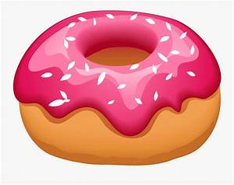
Competitive analysis in the Marketing strategy of Dunkin Donuts –
Dunkin Doughnuts compete in (QSR) quick service restaurants segments in the fast food industry. It faces competition from various types of fast food formats such as convenience stores restaurants and other outlets which are in the business of doughnuts, muffins, ice cream, coffee etc.

Slide 11
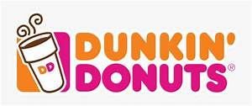
Market analysis in the Marketing strategy of Dunkin donuts –
The fast food chain market is overcrowded with a large number of companies eating out each other share. Since this industry runs in quick service restaurants segment and operating on the franchised model the exit and entry risk lies with the franchise while the company’s operational cost is low. Companies like Teco bell, Tim Hortons, Mac-Donalds, Burger King, Wendy’s etc. compete in this industry.

Slide 12
Customer analysis in the Marketing strategy of Dunkin Donuts –
Customers of Dunkin Donuts are the millennial and middle age group customers who are interested in eating in joints or fast food restaurants. A major group of customers of Dunkin Donuts are the college or school-going teenagers.

